Slide 1
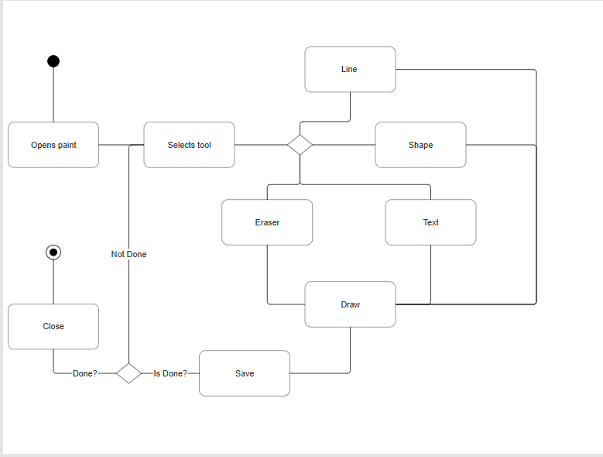
Activity Diagram:

Slide 2
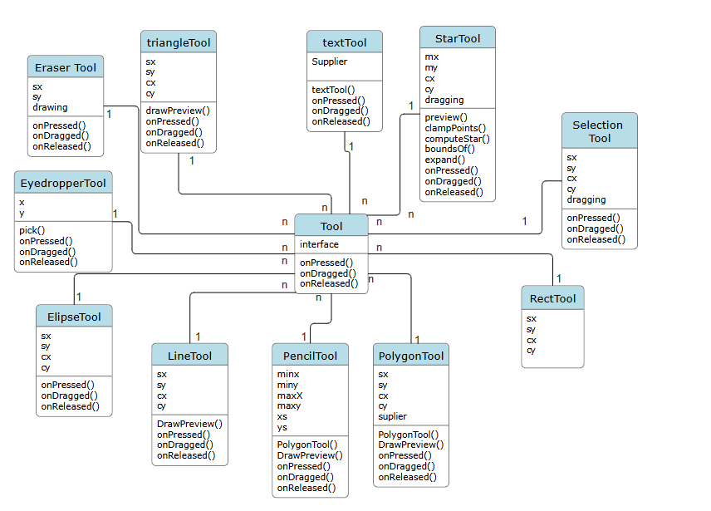
Class Diagram for Tools:

